Slide 1

mobile biofeedback health apps
Prepared for CS183 Pitch 5/22

Slide 2

Azumio Apps
Azumio reduces the barrier to monitoring vital health signs by making it into an app on your mobile device
Problem: There is a gap between when you are not feeling well and when you visit a doctor and get tested. Patients can't easily get immediate and convenient feedback on basic health tests
Solution: Azumio leverages the capabilities of smartphones to create systems that can perform these basic health checks anywhere
Prepared for CS183 Pitch 5/22

Slide 3
The Azumio Team
Peter Sefton - Chief Executive Officer
Experience at a mobile application early stage startup. Raised several rounds of funding
B.A. Stanford (STS)
Zahara Docena - Chief Technical Officer
Experience at an early stage startup prior to pursuing Master's degree with a concentration in Human Computer Interaction
B.S. USF (Computer Science and Math), M.S. Stanford (Computer Science)
Mayank Sanganeria - Product Design
Experience in designing multimedia experiences on mobile devices and laptops
B.Tech IIT Bombay (Physics) , M.A. Stanford (Music Science and Technology)
Prepared for CS183 Pitch 5/22

Slide 4
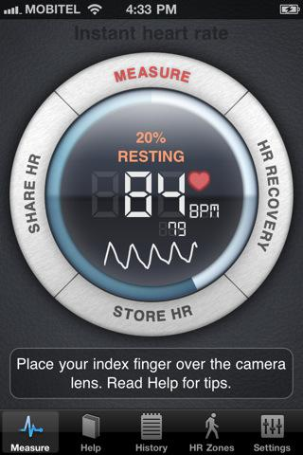
The Products - Instant Heart Rate
Measures heart rate in 10s by user putting finger on camera
- Can help check for :
Heart Disease
Arrhythmia
Stress
Atrial Fibrillation
Diabetes
- 8 million downloads in 9 months
- Remembers timeline of heart beats
http://www.azumio.com/
Prepared for CS183 Pitch 5/22

Slide 5
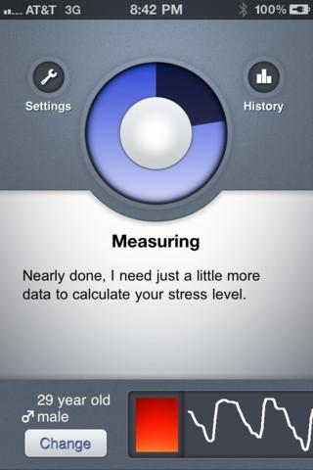
The Products - Stress Check
Uses heart rate variability to quantify stress
- Reduces chances of chronic illness
- Helps pinpoint the source of stress which can then be reduced
Prepared for CS183 Pitch 5/22

Slide 6
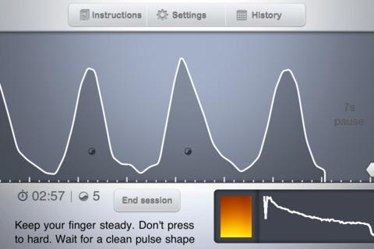
The Products - Stress Doctor
Provides techniques for lowering stress score
- Reduces stress through breathing patterns
- Real-time biofeedback device
Prepared for CS183 Pitch 5/22

Slide 7
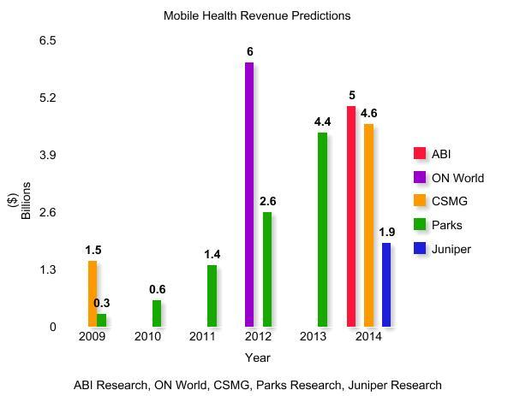
The Market
"ABI Research recently released a report which predicts that the sports and health mobile app market is on pace to hit $400 million in revenues by 2016."
Prepared for CS183 Pitch 5/22

Slide 8
The Competition
iPhone apps
Heart Rate+ etc. - $1
emWave
emWave 2 - $230
emWave Desktop - $250
Omron
Heart Rate Monitor Watch - $50
Nike
Nike+ - $30 + shoe
Heart rate monitor wristwatch - $60
Nike+ FuelBand - $100 (extra features)
Jawbone
Up! Band - $100 (extra features)
Prepared for CS183 Pitch 5/22

Slide 9
The Market
In addition to low priced apps, we currently offer free versions of all our apps which gain revenue through ads.
Product | Price Point | Additional Revenue
Instant Heart Rate | $0.99 | N/A
Stress Check | $0.99 | N/A
Stress Doctor | $7.99 | N/A
Instant Heart Rate Lite | Free | Ad Revenue
Stress Check Lite | Free | Ad Revenue
Prepared for CS183 Pitch 5/22

Slide 10
The Distribution
Continue App Store and Google Play Distribution
More than 14 million downloads
Ads for new products on current products
Referrals by doctors in the future
Prepared for CS183 Pitch 5/22

Slide 11
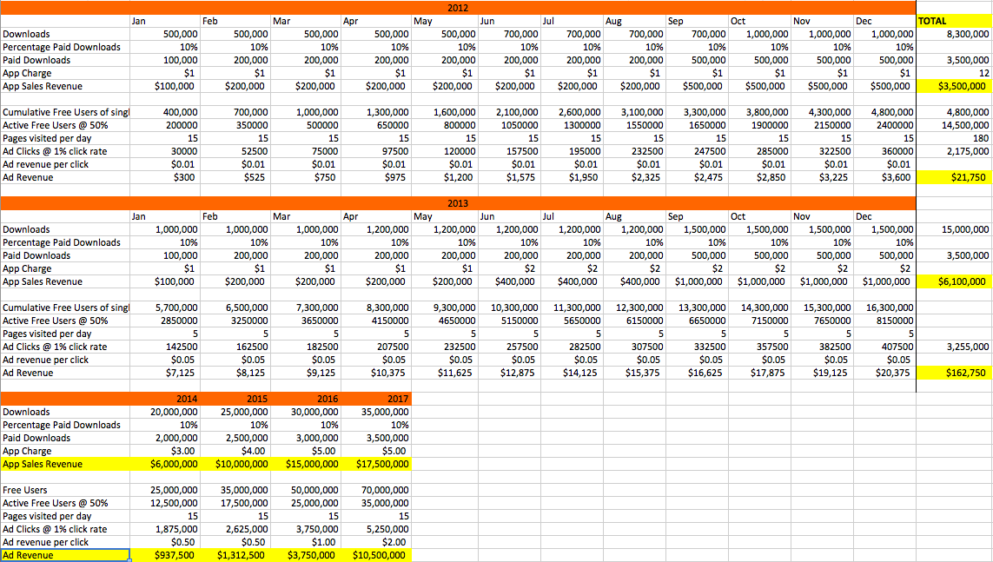
Financial Model & Assumptions
Prepared for CS183 Pitch 5/22

Slide 12
Barriers
Barriers to Entry
Technological development of software using iPhone sensors
Barriers to Exit/ Network Effects
Health history data records on Azumio
Network of doctors
Unified ecosystem for managing your personal health records
Prepared for CS183 Pitch 5/22

Slide 13
Funding History
Proceeds from Series A will fund incoming engineers. The remaining of the funds will provide for operating costs.
Stage | Investors | Amount | Valuation (pre-)
Seed | Self funded | $250,000.00 | N/A
Current Cash On Hand | Runway (Low Spend) | Runway (Medium Spend) | Runway (High Spend)
$90,000.00 | 6 months | 4.5 months | 3 months
Prepared for CS183 Pitch 5/22

Slide 14
Series A
Seeking $3 million for Series A
Ramp up development of new apps
Develop / Test accelerometer band
Hire 5 engineers @ $80,000 / year
Hire 2 sales people @ $50,000 / year
Runway of 2 more years
Prepared for CS183 Pitch 5/22

Slide 15
Future Prospects & Vision
Vision - connect patients to doctors over the internet in real time
Doctors can
request for patients' heart rate at any time
set up alerts to themselves in case a vital sign comes irregular
monitor a lot more health data about their patients
Developers can use our API to provide for even more use of patients' medical data
Prepared for CS183 Pitch 5/22

